Slide 1
STAT 515- FINAL PROJECT PRESENTATION
Instructor: Professor Daniel B. Carr
Nikitha Kacham
G01007820

Slide 2
WHY House Price Predictions
Very interesting topic, can find lots of patterns with various predictors
Extracted the dataset from : Kaggle – House price predictions
The sale price of a house can be predicted based on various factors
All the information in the dataset have specific abbreviations
Based on 1460 observations and 81 various factors we can own a house

Slide 3
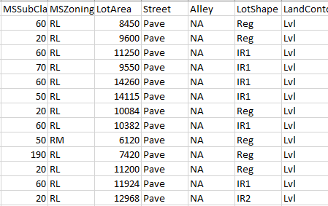
Data set
Data cleaning:
Removed n/a values
Using the Function which Counts n/a values per column
Cleaned dataset has 1460 observations and 64 variables

Slide 4
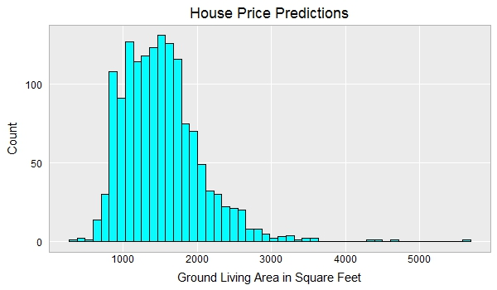
Histogram – Ground living area

Slide 5
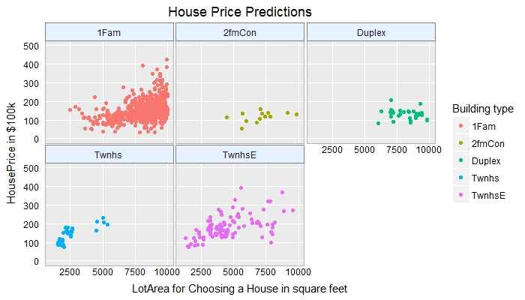
Juxtaposed Scatter plot

Slide 6
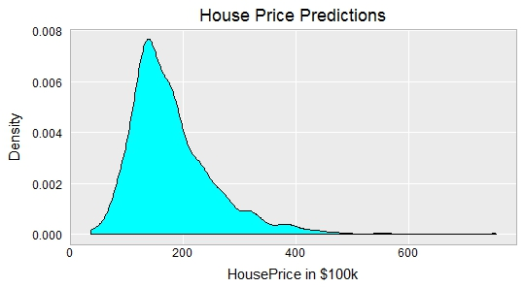
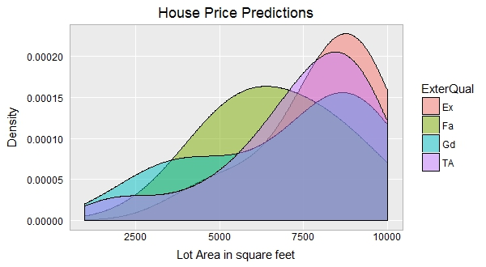
Density plot – Kernel and Superposed

Slide 7
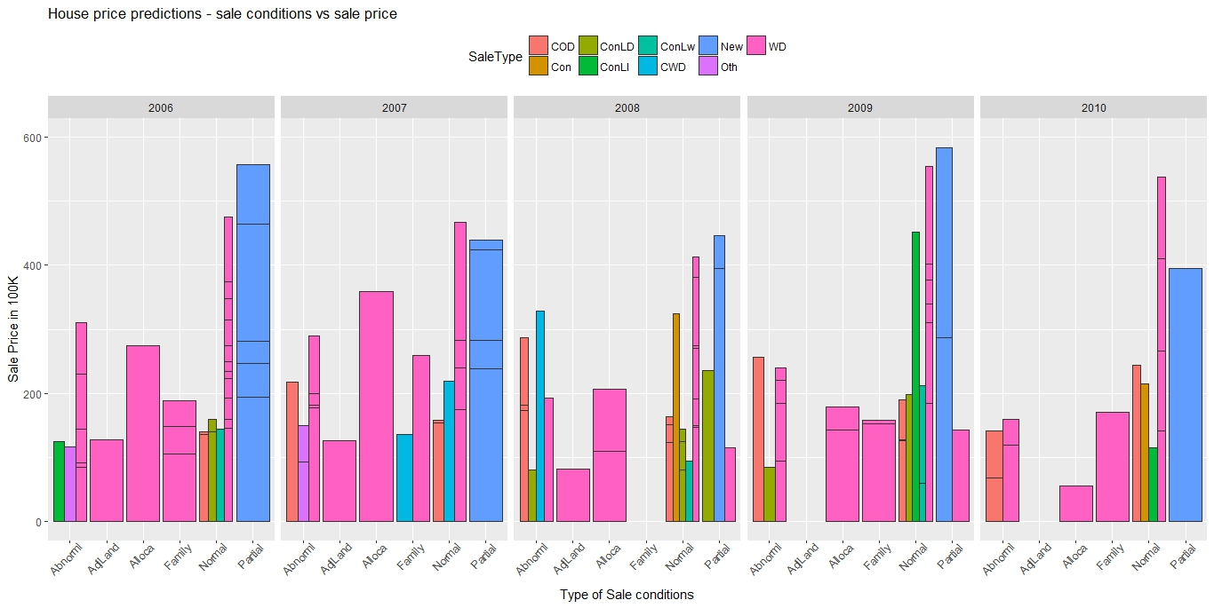
House Price Predictions GGPLOT – sale condition vs sale price

Slide 8
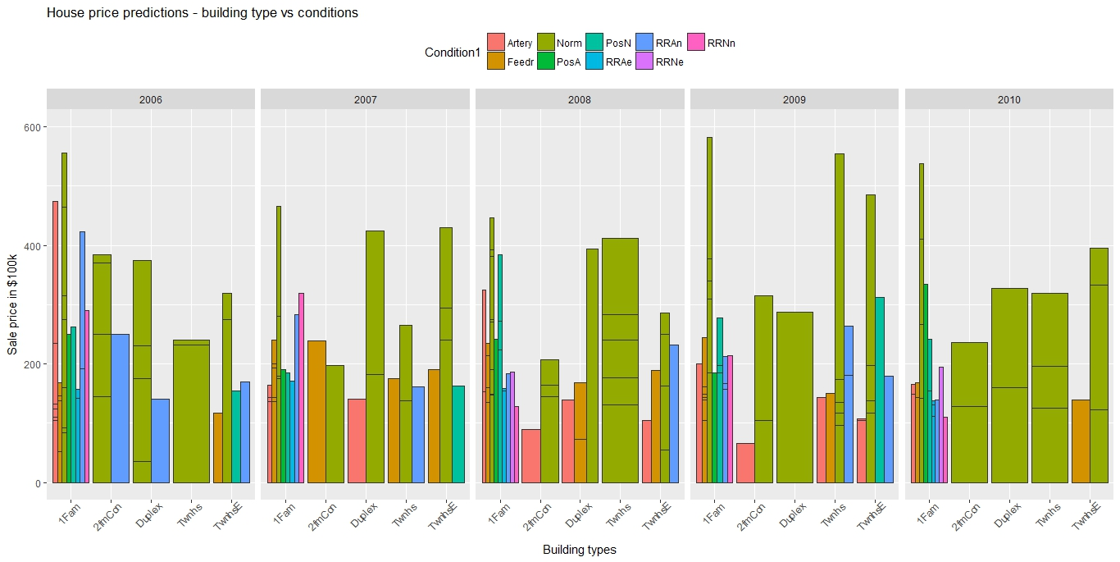
GGPLOT – Building Types vs Proximity to various conditions

Slide 9
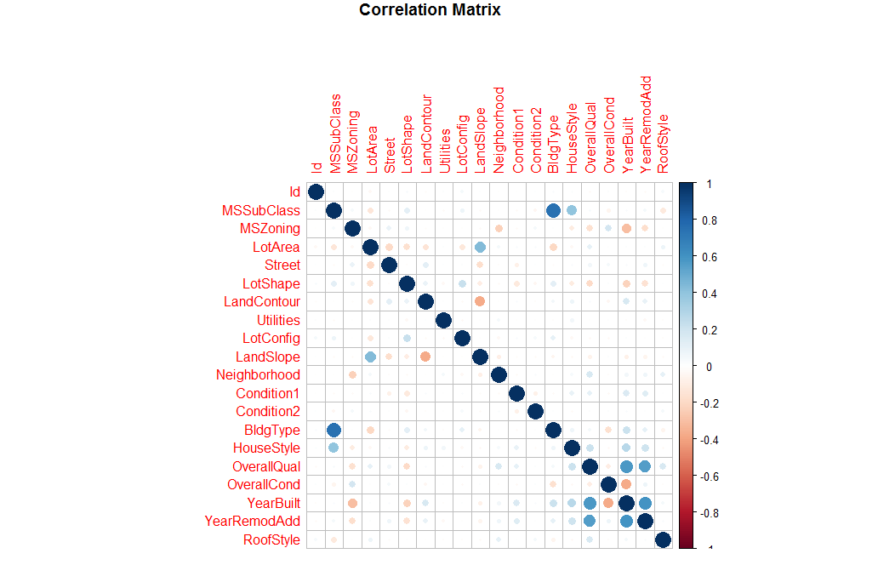
Correlation Plot
Corrplot for Important variables

Slide 10
Modeling
Feature Importance
Random Forest
Variable Importance
Error rate plot
Linear Regression
Step Regression

Slide 11
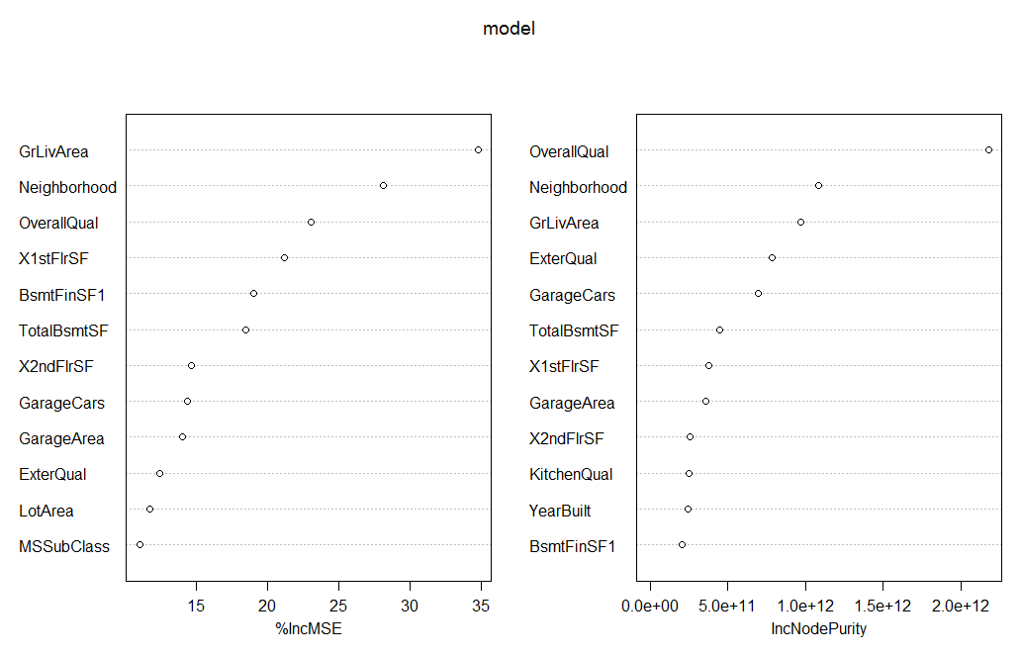
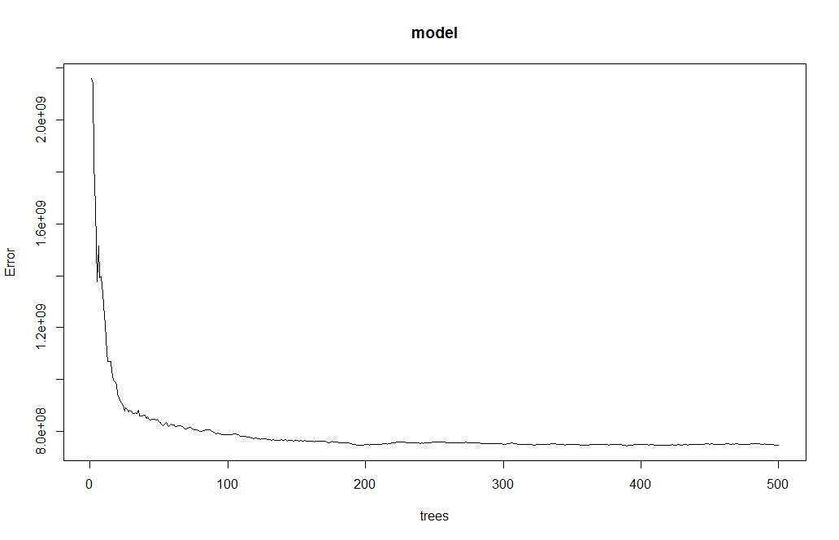
Variable Importance Plot Error Rate plot

Slide 12
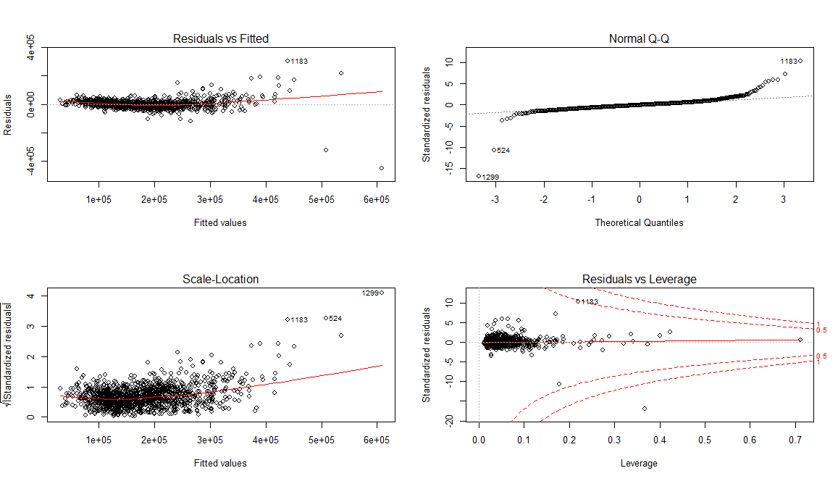
Regression model

Slide 13
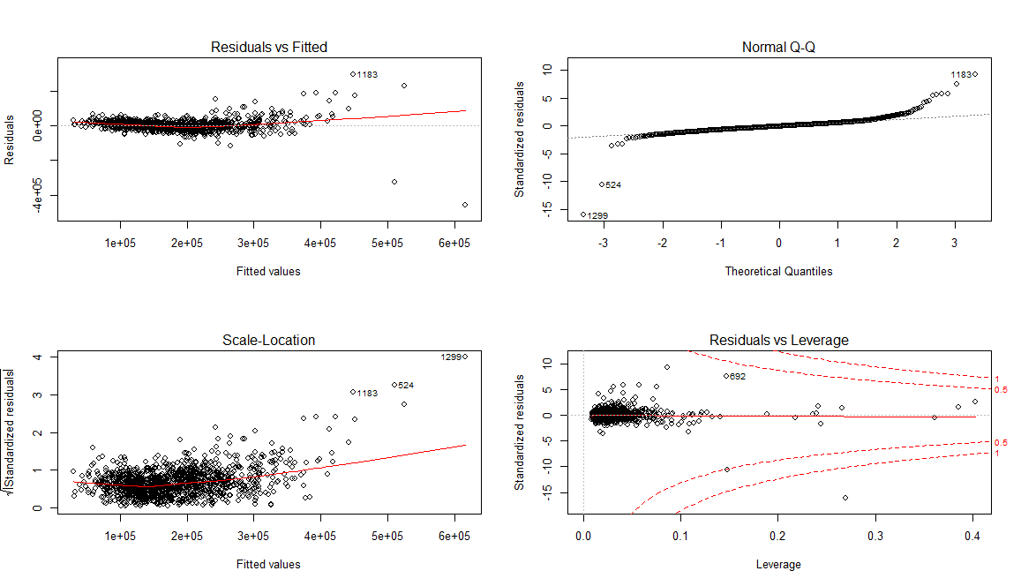
Step Regression model

Slide 14
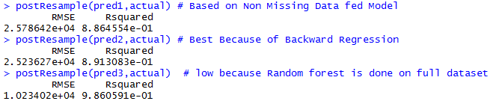
Observations
Models | Multiple R- squared value | Adjusted R- squared value
Regression model – FIT | 0.8331 | 0.8245
Step regression model - UPFIT | 0.8311 | 0.826
Root mean square Deviation

Slide 15
Conclusion
Data cleaning was done successfully
Interpretations on predicting the sale price based on Type of sale conditions is done using ggplots
The Adjusted R-squared value for the regression model is 0.8245
Upfit – step regression Adjusted r-squared value is 0.83
Modeling random forest for variable importance and error rate of the model
Linear regression and step regression is done for accuracy of the model.

Slide 16
Thank You
Any suggestions?

